Slide 1
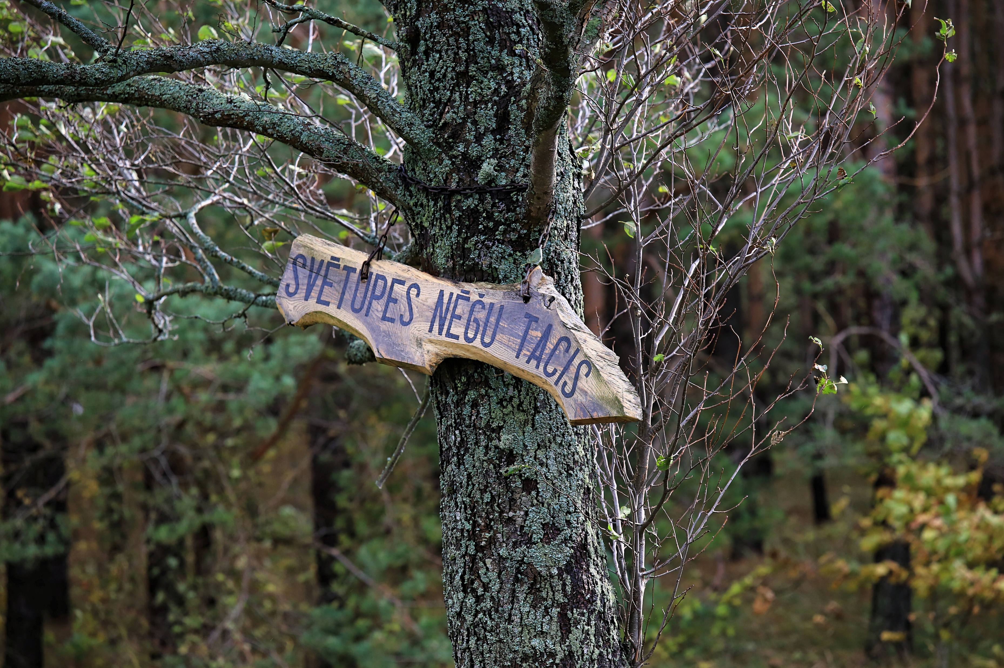
LAMPREY CATCHING IN SVĒTUPE
Inese Koluškina,
Co-owner of Svētupe lamprey trap
ILEEE in Riga,
28th October, 2020

Slide 2
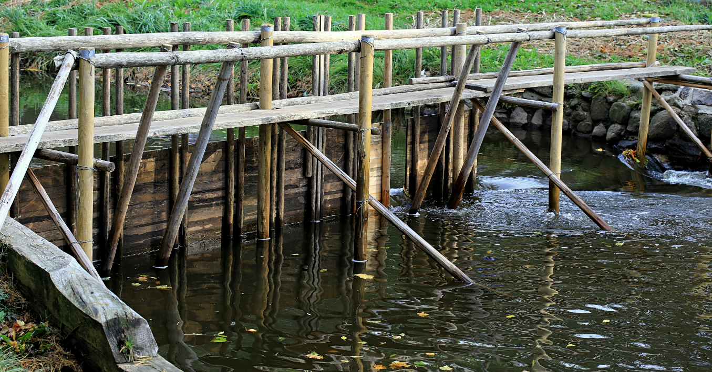
WHERE DOES THE IDEA OF A LAMPREY TRAP COME FROM?
Catching lamprey with a trap is a very old method. The Svētupe lamprey trap was made new. In ancient times there was also a trap higher up the river
My husband has started fishing lamprey about 15 years ago
The lamprey-cathing season is from August 1 - January 31

Slide 3
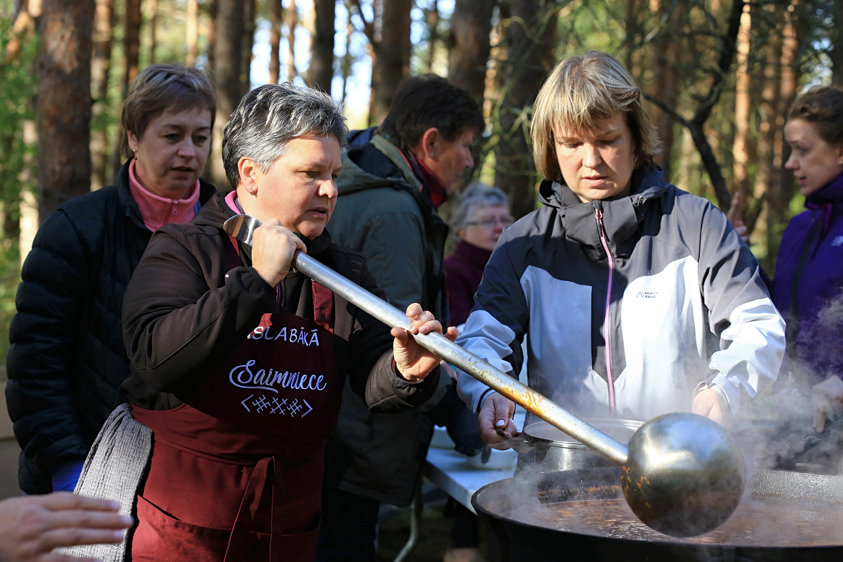
HOW MANY PEOPLE ARE WORKING IN THIS BUSINESS?
2 to 3 people – mainly her husband with an assistant their son also sometimes helps and a wife (Inese), if extra help is needed
Mainly Inese is working with accounting documents and cooking lamprey soup for festivals or tours
Photo by Gustavs Vītols

Slide 4
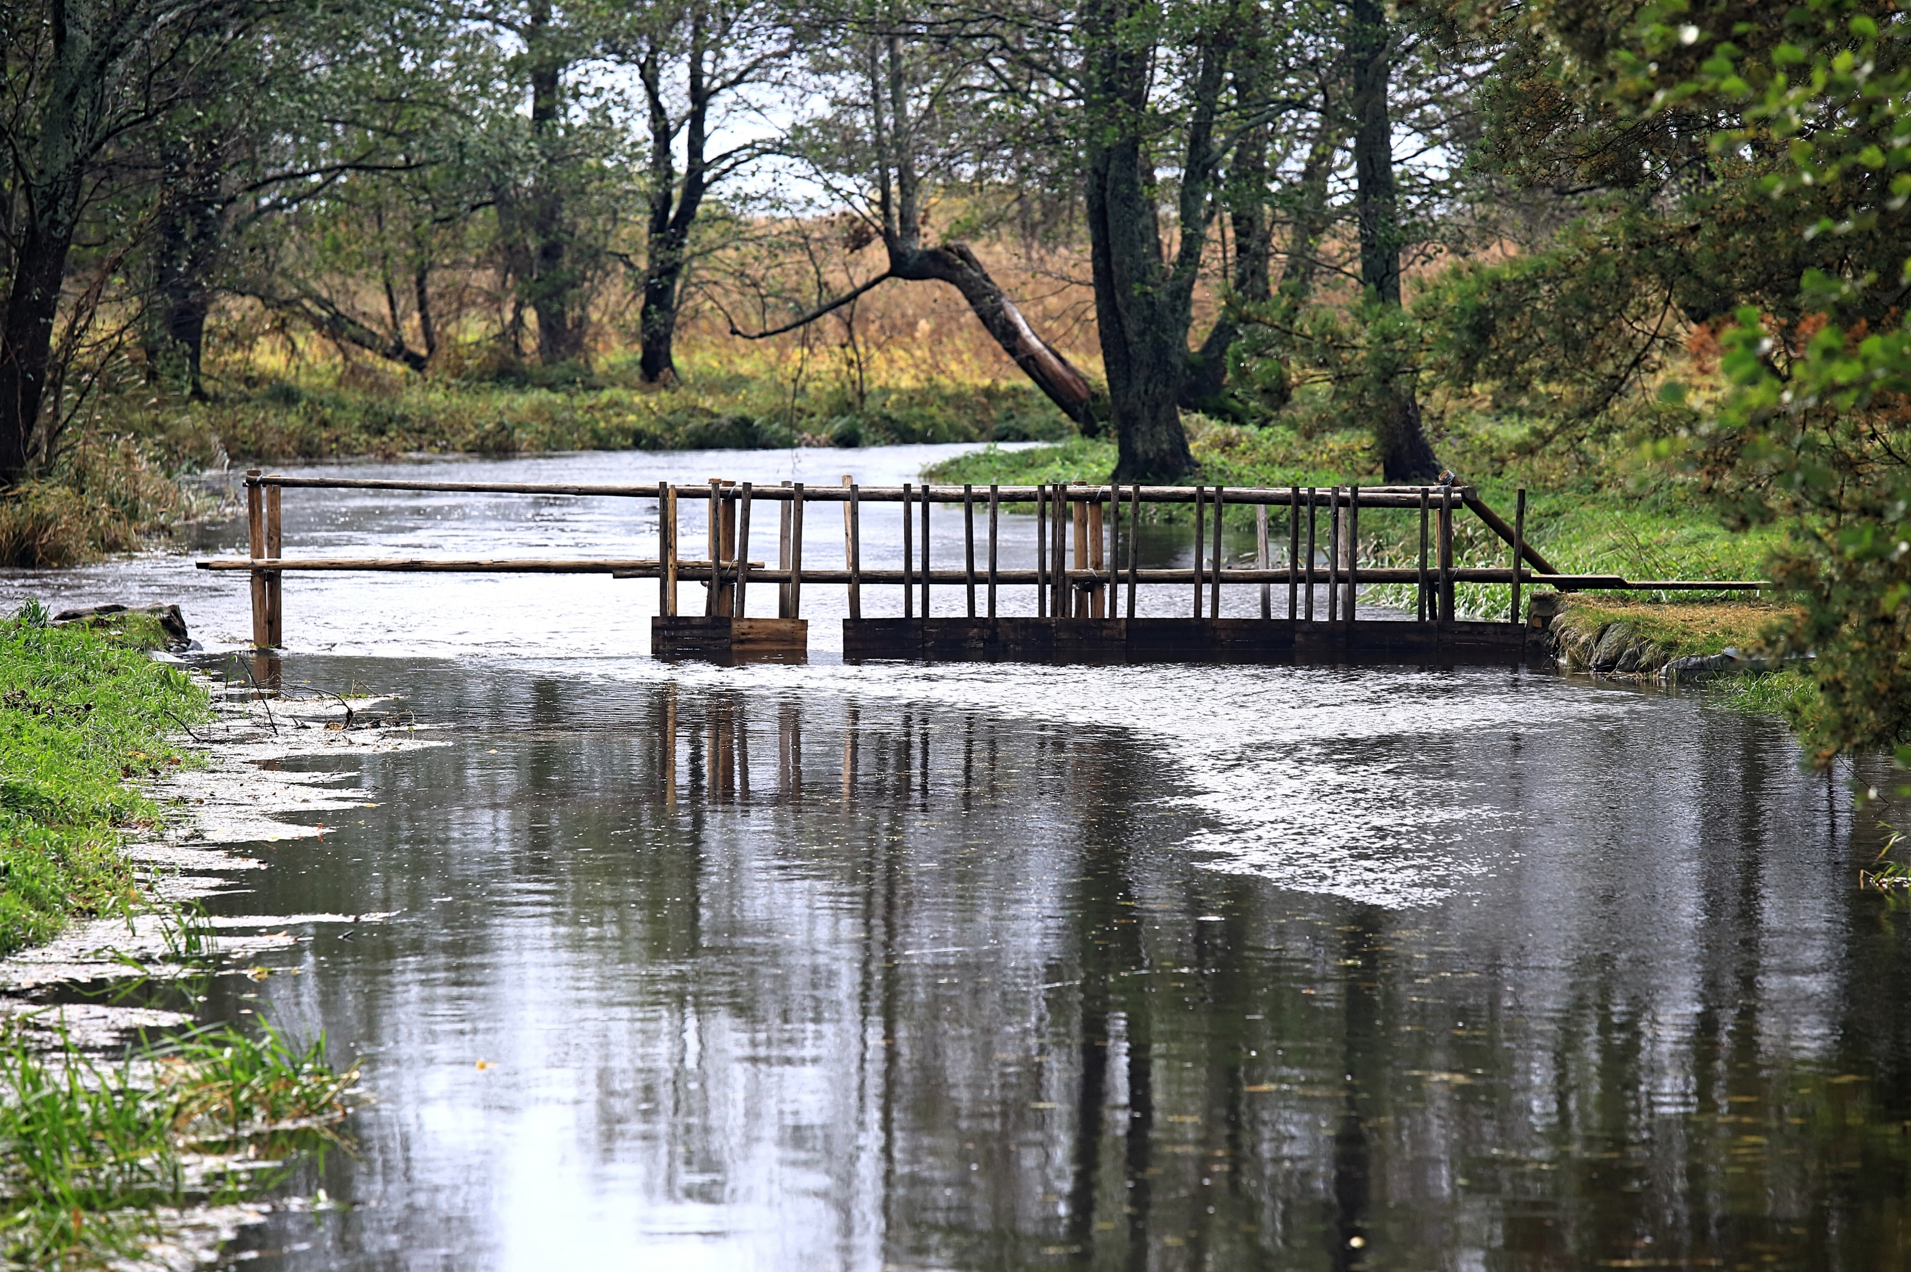
WHAT AFFECTS THE QUANTITY OF LAMPREYS IN THE RIVER?
the direction of the wind
the amount of water in the river
the weather
the full moon - if it's too bright - the lamprey doesn't like it anymore
also the lamprey doesn’t like if the autumn leaves fall in the water - it makes the water bitter and the amount of lamprey decreases

Slide 5
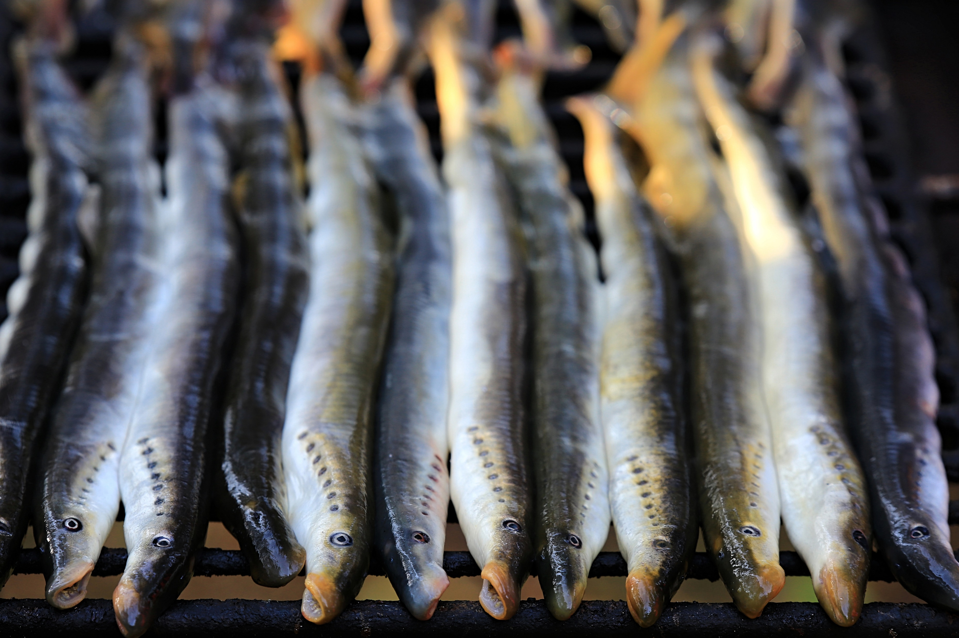

WHERE DO LAMPREYS TRADE TAKE PLACE?
Coastal fish are mostly sold to private individuals, a company that exports to Ukraine, and lamprey is also sold to local processors.
IS THERE A COOPERATION WITH SALACGRĪVA MUNCIPALITY?
Cooperation is by participating in a lamprey festival, cooking soup. The municipality supports, for example, by financing soup ingredients

Slide 6
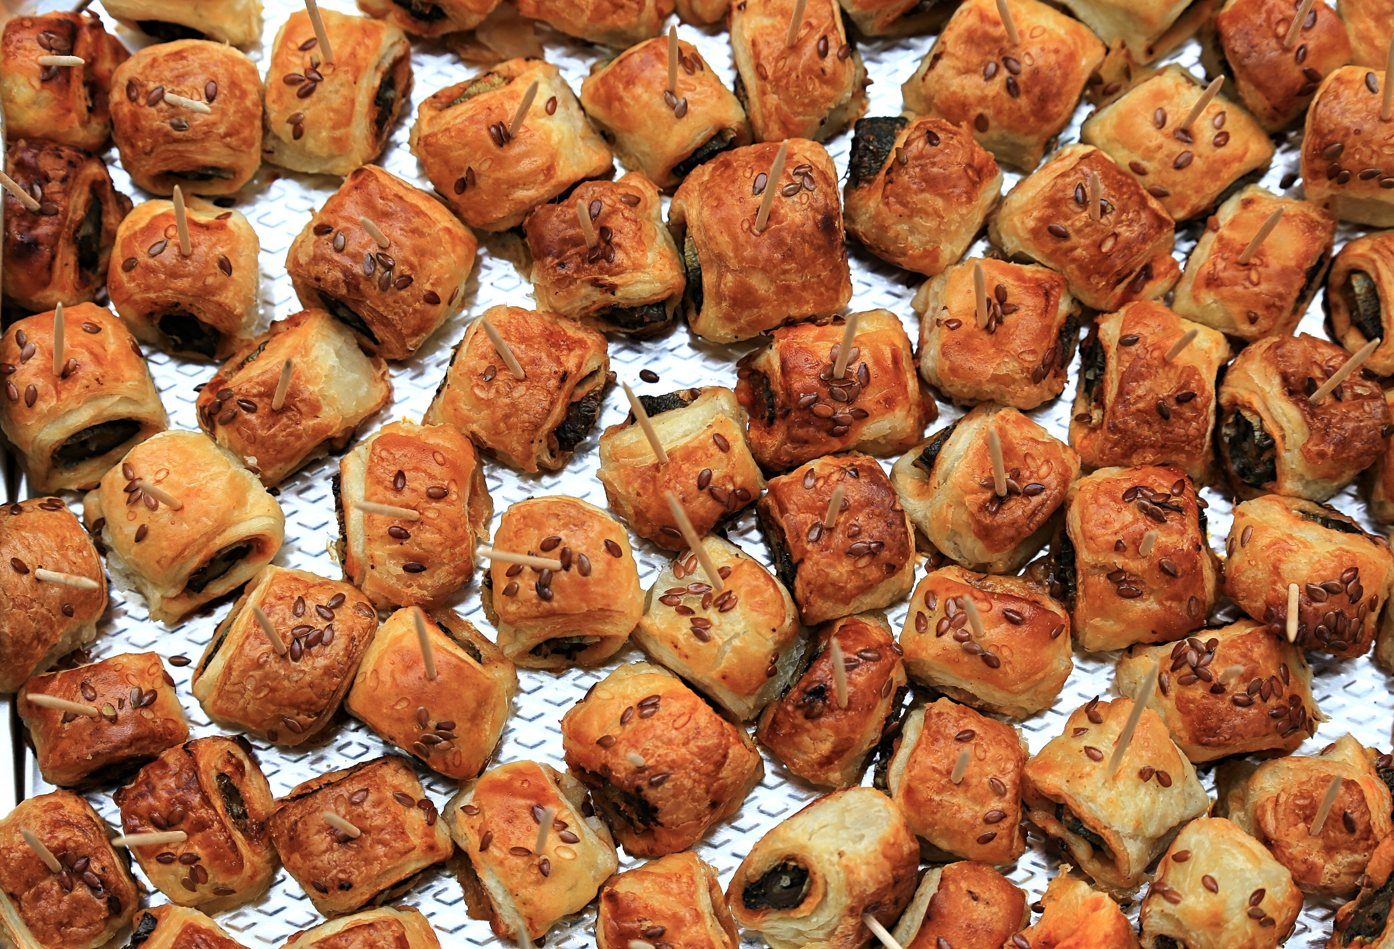
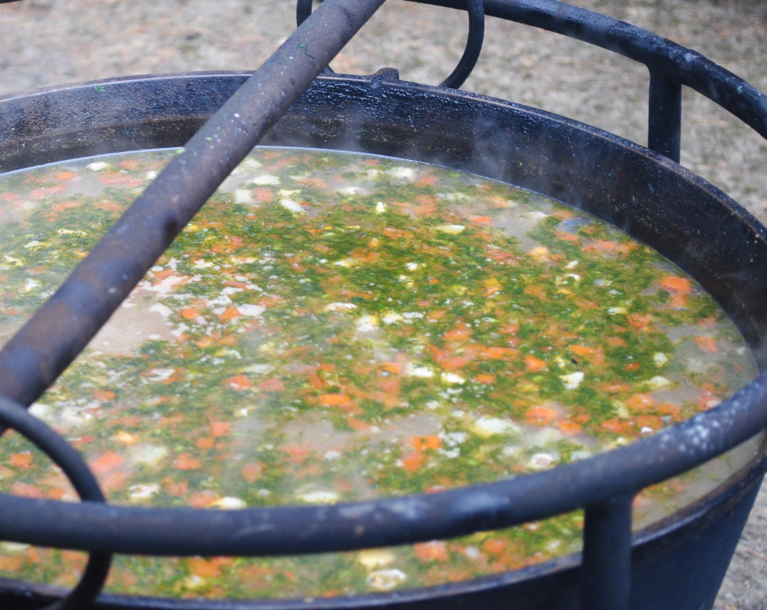
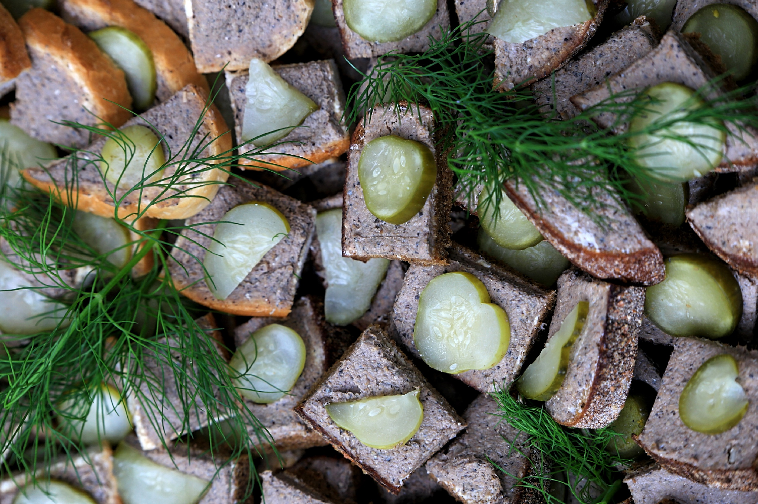
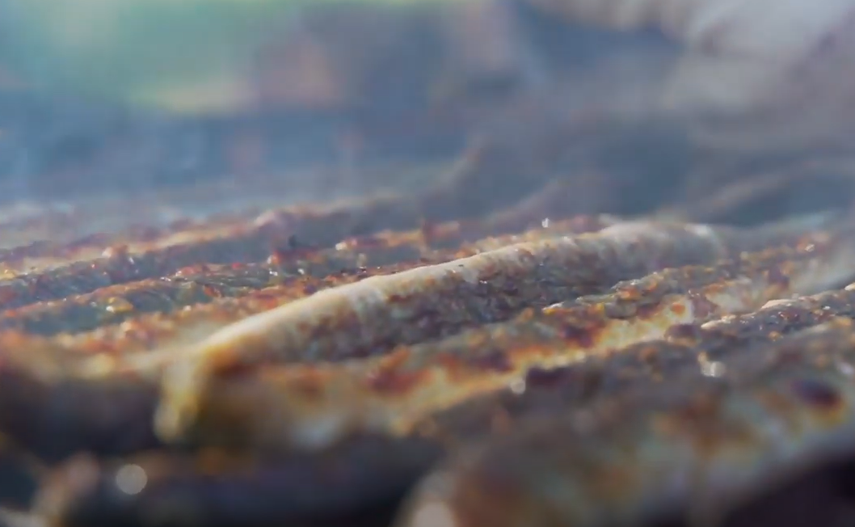
WHAT TASTEs BETTER: FRIED LAMPREY OR a SOUP?
Both taste good, we also make lamprey patties and lamprey gallery, pate, but visitors during lamprey festival probably like best lamprey soup, because 150 liters of soup is eaten within one hour.

Slide 7
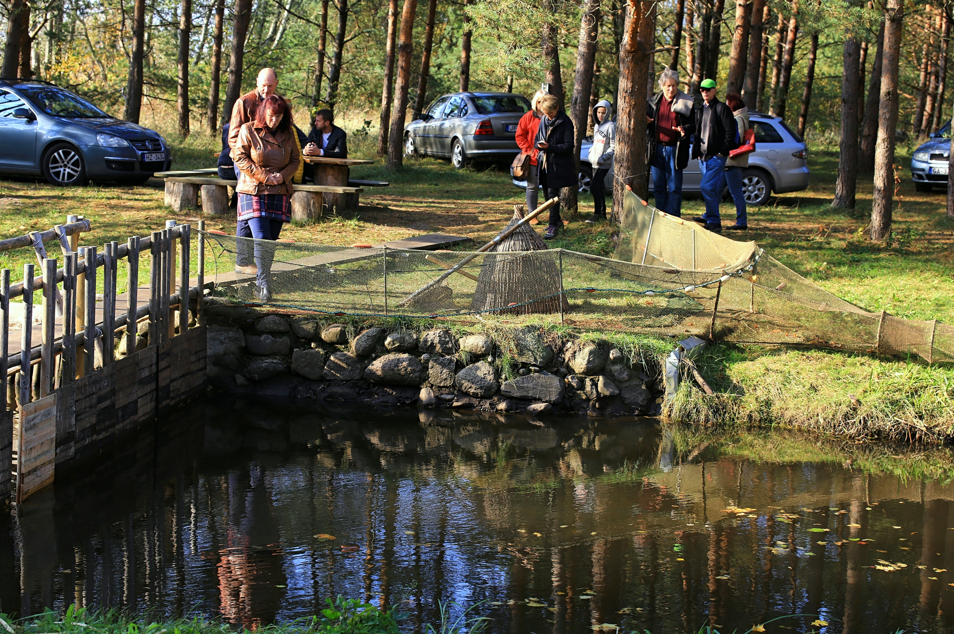
HOW tours are ORGANISEd?
During the excursions you can see the process of lamprey catching (in winter the tour can start earlier, because it quickly gets dark and the lampreys are caught in the dark), then the lampreys are grilled and eaten. If the excursions during the day - it is possible to cook soup.
Excursion costs with soup meal are 10 eur / person, excursion duration ~ 1h

Slide 8
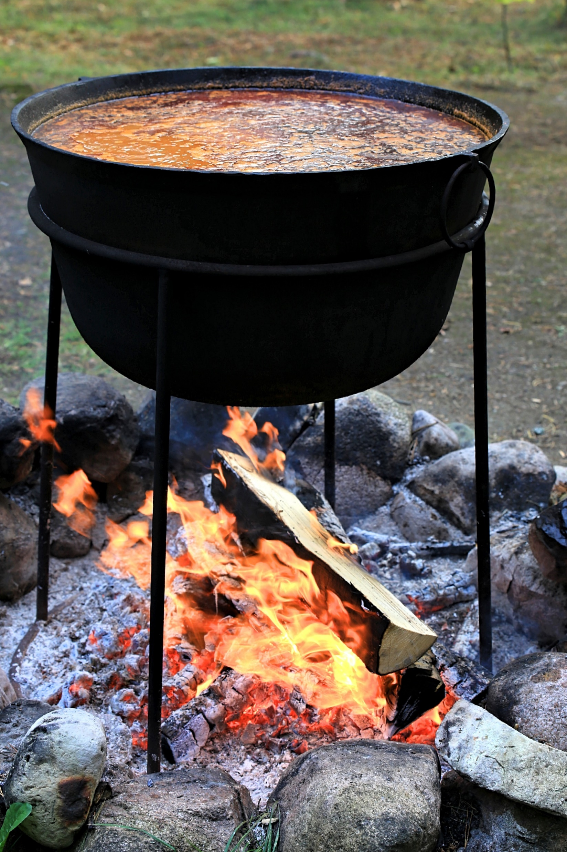
WHAT IS A RECIPE FOR LAMPREY SOUP?
Recipe for lamprey solanka: the main ingredient - grilled lamprey, fried onions, carrots, tomatoes and pickles, potatoes, when it is all cooked, add pickled cucumber juice and tomato paste, ready-made soup-greens.
The soup has a lot of different spices, a bit of love and respect, it all together creates a wonderful and unique taste.

Slide 9
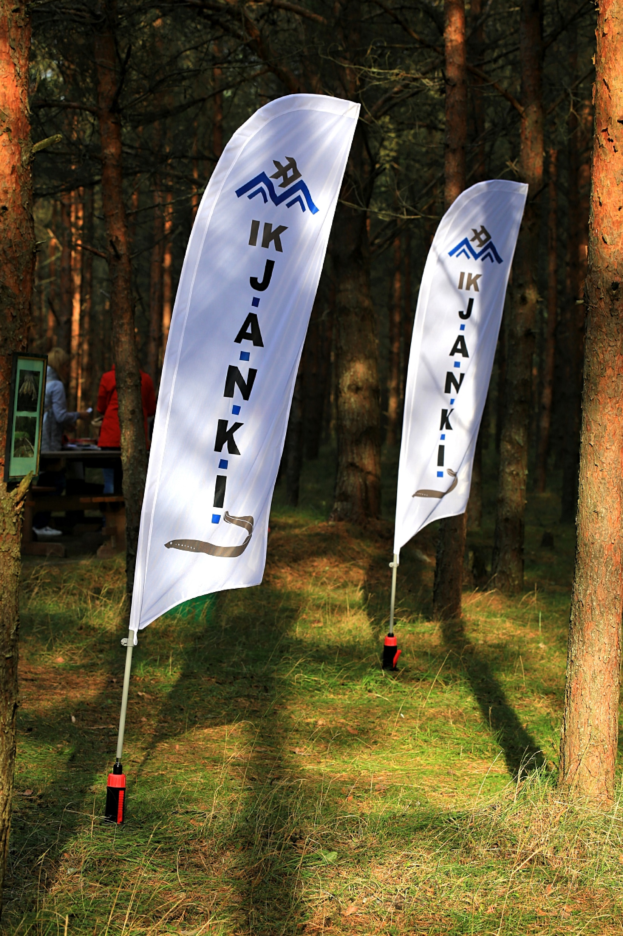
THANK YOU!
WELCOME TO SALACGRĪVA!
More information
http://www.visitsalacgriva.lv/lv/ko-darit/svetupes-negu-tacis/

